Slide 1
Literature Review:
Carbon in Context
Notes:
Note:

Slide 2


Slide 3
What We Know: Carbon Farming
Agricultural methods that aim to sequester atmospheric carbon in the soil
Reduces future emissions
Neutralizes current emissions
Carbon farming has made its way into being used at high rates in carbon markets and carbon offset schemes.

Slide 4
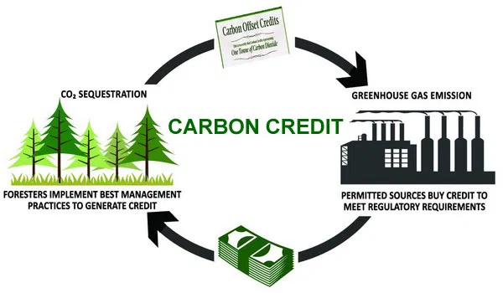
Carbon Markets offset or neutralize carbon footprints by monetizing their emissions elsewhere in the world via tree planting.

Slide 5
Benefits of the Carbon Market
Provides financial and environmental benefits to agricultural partners
Food security
Economic development
Biodiversification and protection of native species
Economic development
Improved soil quality
Sustain growth by subsidizing carbon farming costs

Slide 6

Small-Scale Models in the Carbon Market
Organizations invest in projects that offset their carbon footprint or the carbon emissions of a specific activity
Privately or informally conducted process
Provides financial security for low-income farmers and the promotion of sustainable agroforestry systems

Slide 7
Carbon Farms as an Educational Model
University of Georgia and Costa Rica partnership
Project design similar to Sewanee
Study abroad travel offsets
Wildlife corridor restoration
University of Florida Gainesville
Athletic department partnership
Colgate University
Example of campus with Verified Carbon Standard and for-profit carbon farming model

Slide 8
Consequences of this Model
Difficult to regulate large scale carbon offset projects due to false reporting for economic gain while small scale projects are more honest.
Example: Green Trees
The price of carbon varies worldwide due to a lack of consensus on the carbon market.
$0.10 vs. $50

Slide 9
So, should your institution or you personally invest in carbon sequestration projects?

Slide 10
DUH!
You can save lives, help the planet, and reduce your negative impact on the world
Major businesses and organisations recognise the effects of climate change and are offsetting their carbon footprints.
Will you help save the planet?

Slide 11
Questions?
Notes:
Put carbon emissions into human variables: cars, flights, → how many should you plant to offset XYZ?
Why does sequestering carbon matter?

